Slide 1
An Introduction to NS-3
Dr. Madhukrishna Priyadarsini
Department of CSE
NIT Tiruchirappalli

Slide 2
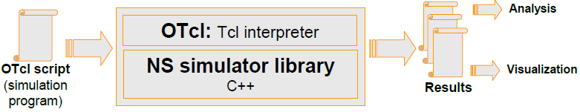
NS3 and Tcl
Toolkit Command Language (Tcl/OTcl) scripts are written to set up/configure network topologies.
C++ is used to write the Event Schedulers and Basic network component objects.
Tcl/OTcl provides linkage for class hierarchy, object instantiation, variable binding and command dispatching.
These compiled objects are made available to the OTcl interpreter through an OTcl linkage that creates a matching OTcl object for each of the C++ objects and makes the control functions and the configurable variables specified by the C++ object act as member functions and member variables of the corresponding OTcl object.

Slide 3
NS-3 Generic Script Structure
Create Simulator object
Turn on tracing
Create topology
Setup link dynamics
Create routing agents
Create application and/or traffic sources
Post-processing procedures (i.e. nam)
Start simulation

Slide 4
Step1: Create Simulator Object
Create event scheduler
set ns [new Simulator]

Slide 5
Step2: Turn on Tracing
Insert immediately after scheduler!
Trace packets on all links
set nf [open out.nam w]
$ns trace-all $nf
$ns namtrace-all $nf

Slide 6
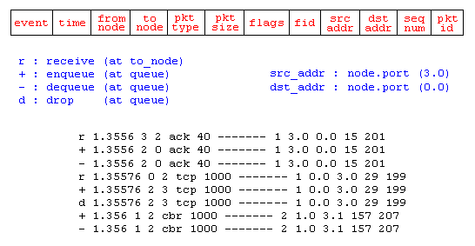
Step2: Turn on Tracing cont…
Structure of Trace File:

Slide 7
NS-3 Generic Script Structure
Create Simulator object
Turn on tracing
Create topology
Setup link dynamics
Create routing agents
Create application and/or traffic sources
Post-processing procedures (i.e. nam)
Start simulation

Slide 8
Step 3: Create network
Two nodes, One link
n0
n1

Slide 9
Step 3: Create Network
n0
Nodes
set n0 [$ns node]
set n1 [$ns node]
Links and queuing
$ns duplex-link $n0 $n1 1Mb 10ms RED
$ns duplex-link $n0 $n1 <bandwidth> <delay> <queue_type>
<queue_type>: DropTail, RED, etc.
n1

Slide 10
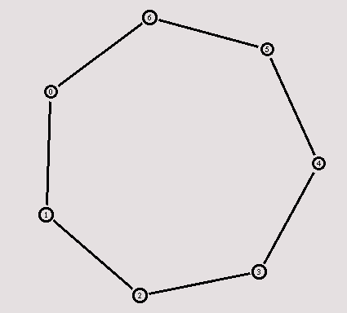
Creating a larger topology
for {set i 0} {$i < 7} {incr i} {
set n($i) [$ns node]
}
for {set i 0} {$i < 7} {incr i} {
$ns duplex-link $n($i) $n([expr ($i+1)%7]) 1Mb 10ms RED
}

Slide 11
NS-3 Generic Script Structure
Create Simulator object
Turn on tracing
Create topology
Setup link dynamics
Create routing agents
Create application and/or traffic sources
Post-processing procedures (i.e. nam)
Start simulation

Slide 12
Step 4: Network Dynamics
Link failures
Hooks in routing module to reflect routing changes
$ns rtmodel-at <time> up|down $n0 $n1
For example:
$ns rtmodel-at 1.0 down $n0 $n1
$ns rtmodel-at 2.0 up $n0 $n1

Slide 13
Step 5: Creating UDP connection
set udp [new Agent/UDP]
set null [new Agent/Null]
$ns attach-agent $n0 $udp
$ns attach-agent $n1 $null
$ns connect $udp $null
udp
n0
n1
null

Slide 14
Step 6: Creating Traffic (On Top of UDP)
cbr
CBR
set cbr [new Application/Traffic/CBR]
$cbr set packetSize_ 500
$cbr set interval_ 0.005
$cbr attach-agent $udp
udp
n0
n1
null

Slide 15
Creating TCP connection
set tcp [new Agent/TCP]
set tcpsink [new Agent/TCPSink]
$ns attach-agent $n0 $tcp
$ns attach-agent $n1 $tcpsink
$ns connect $tcp $tcpsink
tcp
n0
n1
sink

Slide 16
Step 6: Creating Traffic (On Top of TCP)
ftp
FTP
set ftp [new Application/FTP]
$ftp attach-agent $tcp
Telnet
set telnet [new Application/Telnet]
$telnet attach-agent $tcp
tcp
n0
n1
sink

Slide 17
Recall: Generic Script Structure
set ns [new Simulator]
Turn on tracing
Create topology
Setup link dynamics
Create agents
Create application and/or traffic sources
Post-processing procedures (i.e. nam)
Start simulation
Examples

Slide 18
Post-Processing Procedures
Add a 'finish' procedure that closes the trace file and starts nam.
proc finish {} {
global ns nf
$ns flush-trace
close $nf
exec nam out.nam &
exit 0
}

Slide 19
Run Simulation
Schedule Events
$ns at <time> <event>
<event>: any legitimate ns/tcl commands
$ns at 0.5 "$cbr start"
$ns at 4.5 "$cbr stop“
Call ‘finish’
$ns at 5.0 "finish"
Run the simulation
$ns run

Slide 20
Recall: Generic Script Structure
set ns [new Simulator]
Turn on tracing
Create topology
Setup link dynamics
Create routing agents
Create application and/or traffic sources
Post-processing procedures (i.e. nam)
Start simulation
Examples

Slide 21
Visualization Tools
nam-1 (Network AniMator Version 1)
Packet-level animation
Well supported by ns
xgraph
Simulation results

Slide 22
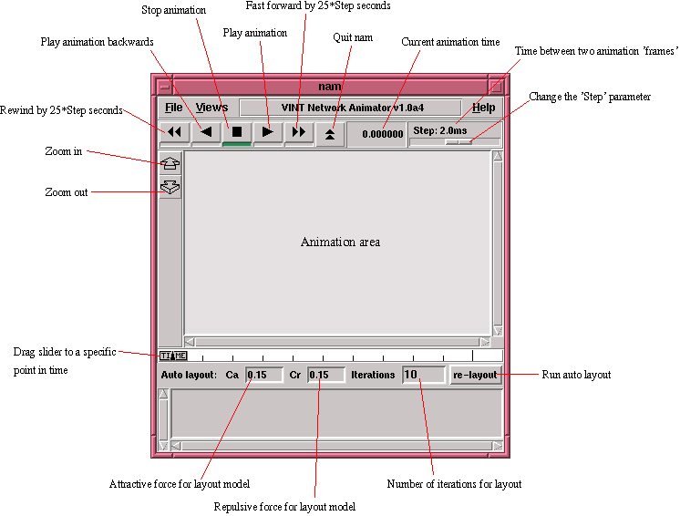

Slide 23
nam Interface: Nodes
Color
$node color red
Shape (can’t be changed after sim starts)
$node shape box (circle, box, hexagon)
Label (single string)
$ns at 1.1 “$n0 label \”web cache 0\””

Slide 24
nam Interfaces: Links
Color
$ns duplex-link-op $n0 $n1 color "green"
Label
$ns duplex-link-op $n0 $n1 label “backbone"

Slide 25
nam Interface: Topology Layout
“Manual” layout: specify everything
$ns duplex-link-op $n(0) $n(1) orient right
$ns duplex-link-op $n(1) $n(2) orient right
$ns duplex-link-op $n(2) $n(3) orient right
$ns duplex-link-op $n(3) $n(4) orient 60deg
If anything missing → automatic layout

Slide 26
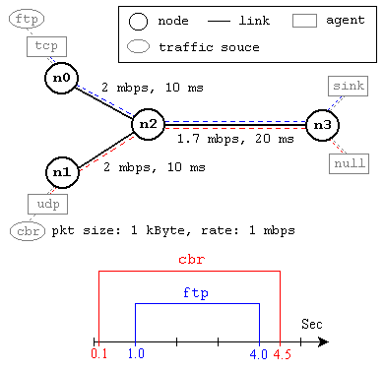
Simulation Example

Slide 27
Simulation Example cont…
#Create a simulator object
set ns [new Simulator]
#Define different colors for data flows (for NAM)
$ns color 1 Blue
$ns color 2 Red
#Open the NAM trace file
set nf [open out.nam w]
$ns namtrace-all $nf

Slide 28
Simulation Example cont…
#Define a 'finish' procedure
proc finish {} {
global ns nf
$ns flush-trace
#Close the NAM trace file
close $nf
#Execute NAM on the trace file
exec nam out.nam &
exit 0
}

Slide 29
Simulation Example cont…
#Create four nodes
set n0 [$ns node]
set n1 [$ns node]
set n2 [$ns node]
set n3 [$ns node]
#Create links between the nodes
$ns duplex-link $n0 $n2 2Mb 10ms DropTail
$ns duplex-link $n1 $n2 2Mb 10ms DropTail
$ns duplex-link $n2 $n3 1.7Mb 20ms DropTail
#Set Queue Size of link (n2-n3) to 10
$ns queue-limit $n2 $n3 10

Slide 30
Simulation Example cont…
#Give node position (for NAM)
$ns duplex-link-op $n0 $n2 orient right-down
$ns duplex-link-op $n1 $n2 orient right-up
$ns duplex-link-op $n2 $n3 orient right
#Monitor the queue for link (n2-n3). (for NAM)
$ns duplex-link-op $n2 $n3 queuePos 0.5
#Setup a TCP connection
set tcp [new Agent/TCP]
$tcp set class_ 2
$ns attach-agent $n0 $tcp
set sink [new Agent/TCPSink]
$ns attach-agent $n3 $sink
$ns connect $tcp $sink
$tcp set fid_ 1

Slide 31
Simulation Example cont…
#Setup a FTP over TCP connection
set ftp [new Application/FTP]
$ftp attach-agent $tcp
$ftp set type_ FTP
#Setup a UDP connection
set udp [new Agent/UDP]
$ns attach-agent $n1 $udp
set null [new Agent/Null]
$ns attach-agent $n3 $null
$ns connect $udp $null
$udp set fid_ 2

Slide 32
Simulation Example cont…
#Setup a CBR over UDP connection
set cbr [new Application/Traffic/CBR]
$cbr attach-agent $udp
$cbr set type_ CBR
$cbr set packet_size_ 1000
$cbr set rate_ 1mb
$cbr set random_ false
#Schedule events for the CBR and FTP agents
$ns at 0.1 "$cbr start"
$ns at 1.0 "$ftp start"
$ns at 4.0 "$ftp stop"
$ns at 4.5 "$cbr stop"

Slide 33
Simulation Example cont…
#Detach tcp and sink agents (not really necessary)
$ns at 4.5 "$ns detach-agent $n0 $tcp ; $ns detach-agent $n3 $sink"
#Call the finish procedure after 5 seconds of simulation time
$ns at 5.0 "finish"
#Print CBR packet size and interval
puts "CBR packet size = [$cbr set packet_size_]"
puts "CBR interval = [$cbr set interval_]"
#Run the simulation
$ns run

Slide 34
Thank you…

